Slide 1



DEPARTMENT OF COMPUTER SCIENCE AND ENGINEERING
Major Project (COM-811) Presentation
B.Tech CSE 8th | Batch 2021-2025
PROJECT TITLE:__________________________________
Team Members:
1. Name (Roll No)
2. Name (Roll No)
3. Name (Roll No)
4. Name (Roll No)
Model Institute of Engineering & Technology (Autonomous)
Notes:
Presentation slide for courses, classes, lectures et al.

Slide 2

Table of Content
Introduction & Problem Statement
Project Objectives
Proposed Solution & Innovation
Methodology (Technology Stack)
System Architecture / Workflow
Implementation
Results / Outcomes
Conclusion
References

Slide 3
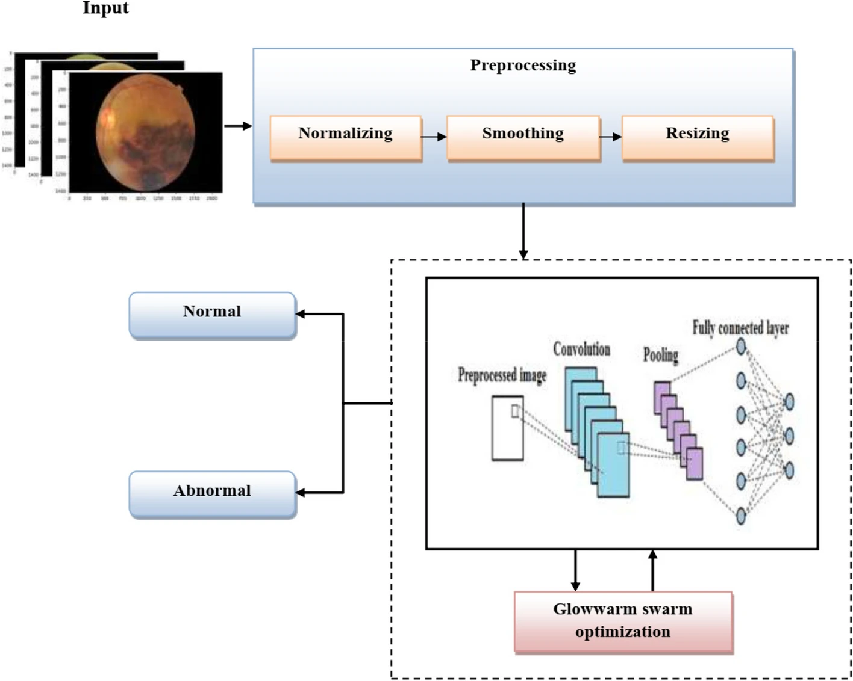
Sample Slide
CNN Learning Cycle
Train on labeled fundus images.
Detect patterns from the images.
Compare predictions with actual results.
Improve accuracy by adjusting filters.
Why CNN?
Automatic Feature Learning [5]
Efficient Pattern Recognition [6]
Superior to FCNs and ANNs [6] [7]
Better for High-Dimensional Images [7]
Fig 1: CNN Work Flow [4]

Slide 4
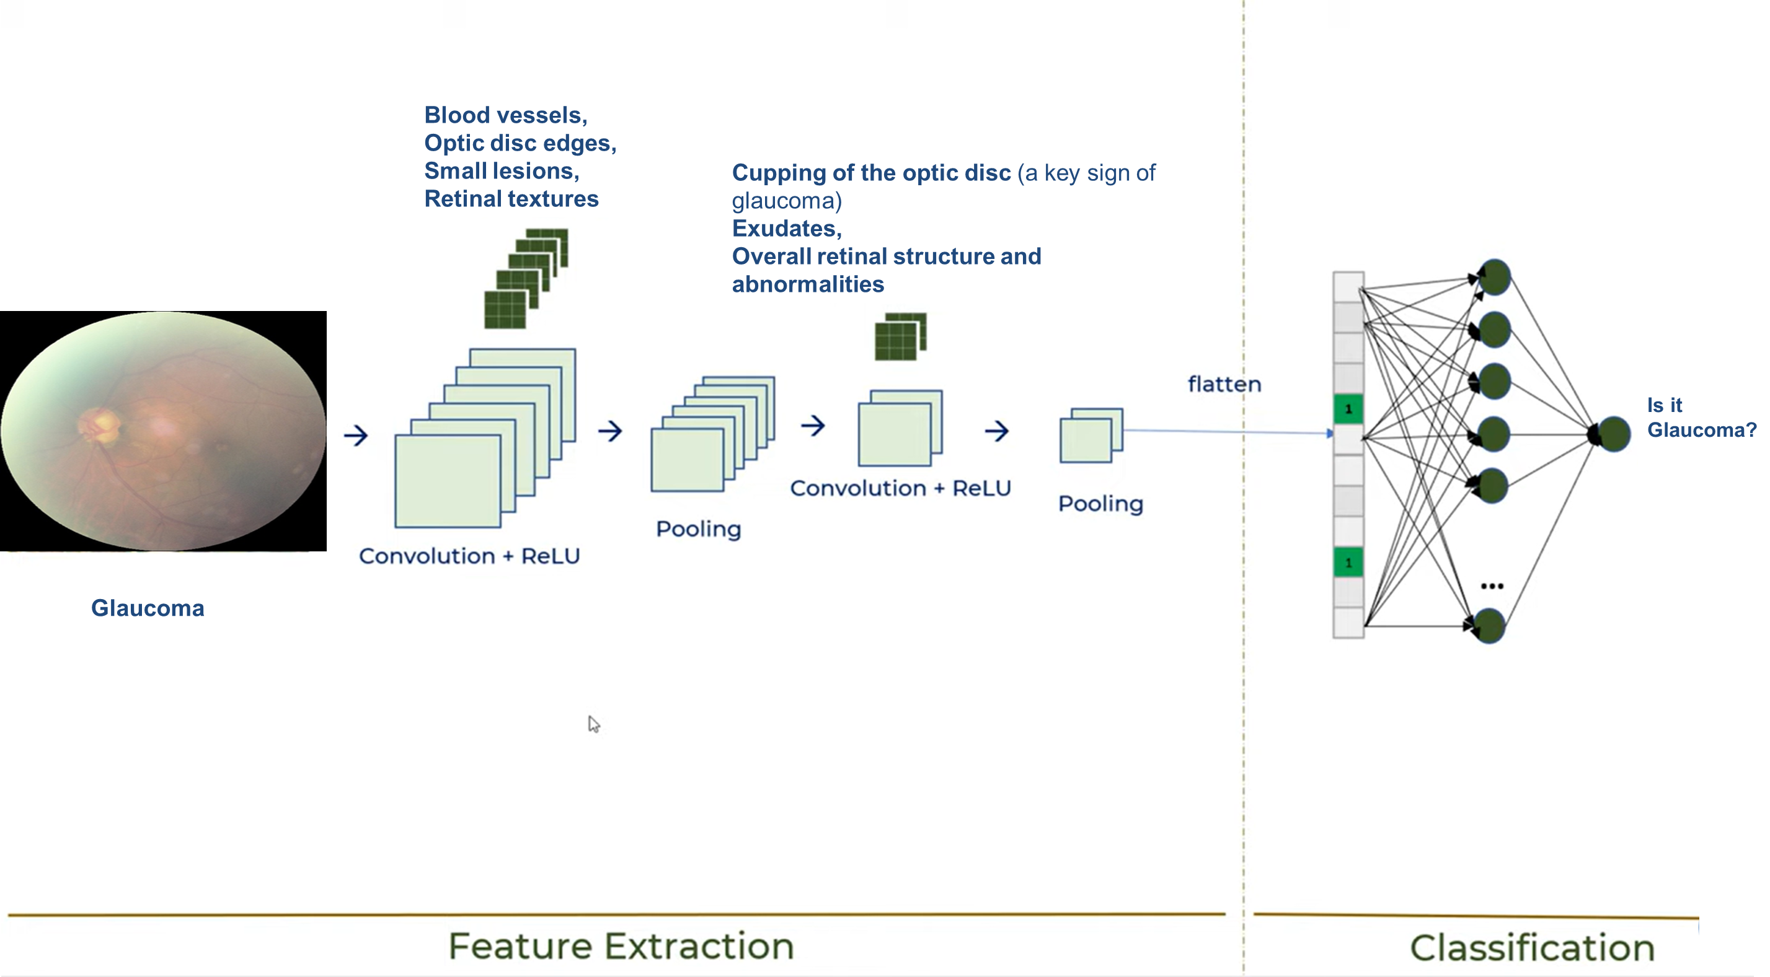
Sample Slide
Fig 2: CNN for Glucoma detection [8]

Slide 5
Title of the Slide

Slide 6
Title of the slide

Slide 7
References [Sample Slide]
S. Hollerer, C. Fischer, B. Brenner, M. Papa, S. Schlund, W. Kastner, et al., "Cobot attack: a security assessment exemplified by a specific collaborative robot", 10th CIRP Sponsored Conference on Digital Enterprise Technologies (DET 2020) - Digital Technologies as Enablers of Industrial Competitiveness and Sustainability, vol. 54, pp. 191-196, 2021.
S. Hollerer, W. Kastner and T. Sauter, "Towards a comprehensive ontology considering safety security and operation requirements in ot", 2023 IEEE 28th International Conference on Emerging Technologies and Factory Automation (ETFA), pp. 1-4, 2023.
S. Kropatschek, S. Hollerer, D. Hoffman, D. Winkler, A. Lüder, T. Sauter, et al., "Combining models for safety and security concerns in automating digital production", 2023 IEEE 21st International Conference on Industrial Informatics (INDIN), pp. 1-8, 2023.
S. Pirbhulal, V. Gkioulos and S. Katsikas, "Towards integration of security and safety measures for critical infrastructures based on bayesian networks and graph theory: A systematic literature review", Signals, vol. 2, no. 4, pp. 771-802, 2021.
M. Wolf and D. Serpanos, "Safety and security in cyber-physical systems and internet-of-things systems", Proceedings of the IEEE, vol. 106, no. 1, pp. 9-20, 2018.

Slide 8
Thank You

